Slide 1
CLER Focus on Health and Health Care Equity
---Voices from the Field
Robin Newton, MD, VP Clinical Learning Environment Review (CLER) Field Operations
Robin Wagner, RN, MHA , SVP, CLER Program
Accreditation Council for Graduate Medical Education (ACGME)
AIAMC Webinar – March 3, 2022
Noon – 1:00pm CT

Slide 2
Accreditation, Designation and Disclosure
This activity has been planned and implemented in accordance with the accreditation requirements and policies of the Accreditation Council for Continuing Medical Education through the joint provider ship of Ochsner Clinic Foundation and the AIAMC National Initiative. The Ochsner Clinic Foundation is accredited by the ACCME to provide continuing medical education for physicians.
The Ochsner Clinic Foundation designates this live activity for a maximum of 1 AMA PRA Category 1 Credits™. Physicians should claim only the credit commensurate with the extent of their participation in the activity.
The Ochsner Clinic Foundation relies upon invited speakers at all sponsored continuing medical education activities to provide information objectively and free from bias of conflict of interest. In accordance with ACCME and institutional guidelines pertaining to potential conflicts of interest, the faculty for this continuing medical education activity has been asked to complete faculty disclosure forms. In the event invited speakers indicate a relationship which, in the context of the subject of their invited presentation, could be perceived as a potential conflict of interest, their materials have been peer reviewed in order to ensure that their presentations are free of commercial bias.

Slide 3
Questions
How do health and healthcare disparities relate to health and healthcare equity?
What has the CLER program taught us about efforts to eliminate health disparities?
What are CLEs doing to identify and eliminate health care disparities?
How can talking about equitable outcomes facilitate efforts to eliminate health care disparities?

Slide 4
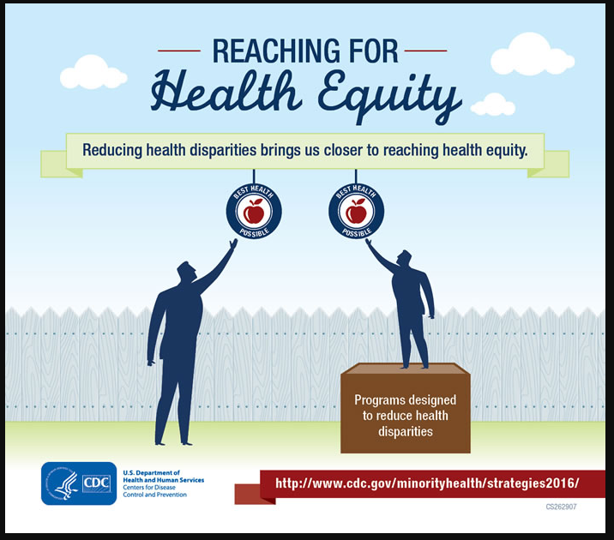
How do health disparities relate to health equity?
Health disparities are preventable differences in the burden of disease, injury, violence, or in opportunities to achieve optimal health experienced by socially disadvantaged racial, ethnic, and other population groups, and communities. (CDC)
Health inequities are reflected in differences in length and quality of life; rates and severity of disease, access to treatment, disability, and death. (CDC)
Health equity is achieved when every person has the opportunity to “attain one’s full health potential” and no one is “disadvantaged from achieving this potential because of social position other socially determined circumstances.” (CDC)

Slide 5
Health Equity
“Health equity is a process. .. Achieving health equity requires three things: Valuing all individuals and populations equally, recognizing and rectifying historical injustices, and providing resources according to need.” Dr. Camara Jones

Slide 6
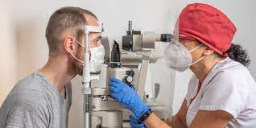

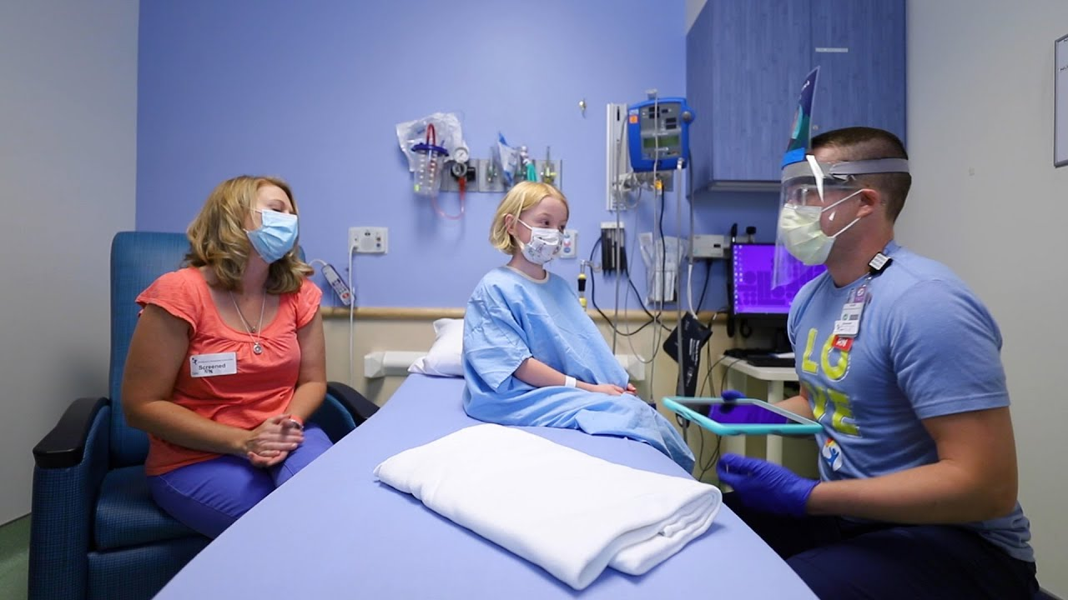
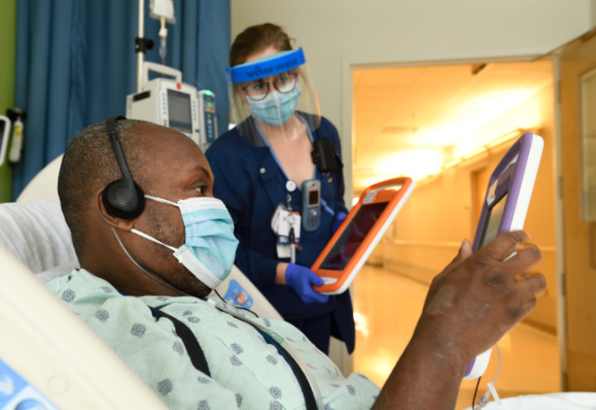
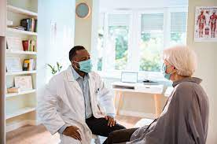
The Clinical Learning Environment
Learning about the impact of the pandemic on CLEs
Notes:
Stratified random sample of approximately 300 remote visits to SIs (stratified by census region and number of ACGME-accredited core programs)
Pre-visit surveys (patient safety and executive leadership)

Slide 7
CLER COVID Protocol
Stratified random sample of approximately 300 SIs (stratified by census region and number of ACGME-accredited core programs)
Remote visit
Selected aspects of CLER Focus Areas (Pathways 2.0)
Unique areas of focus—impact on business and clinical operations, impact on GME training
Pre-visit surveys (patient safety and executive leadership)

Slide 8
What do the CLE leadership voices tell us about what their CLEs have learned about HD in their community?*
CLEs largely stated that the pandemic has reaffirmed their pre-pandemic understanding of health disparities in their community
*Results are preliminary and are gathered from 250 CLER COVID Site Visits conducted between October 2020-December 2021

Slide 9
What have been new actions that CLEs have taken to mitigate health disparities since the onset of the pandemic?*
Many CLEs state that they have expanded and continued efforts to seek partnerships in the community to benefit patients negatively affected by health disparities
*Results are preliminary and are gathered from 250 CLER COVID Site Visits conducted between October 2020-December 2021

Slide 10
Case I
A 10-year review of all patients with breast cancer treated by a rad-onc department showed that their West-Indian patients were more likely to present with advanced stages of disease despite having access to free breast ca screening (cases were adjusted for age). Closer questioning determined that these patients were aware of the free breast cancer screening program.
(Adapted from a case from the field)

Slide 11
Question for Discussion
What would be the first steps in understanding why this patient population does not get regular mammograms?

Slide 12
Patient Voices from the CLE
Interviews of patients from this population revealed the following concerns:
Talking too much about breast cancer could result in someone you know getting it (fatalism)
Radiation should be avoided whenever possible; not sure getting mammography for prevention was safe
Repeated mammography (radiation) could lead to breast cancer.

Slide 13
Question for Discussion
What recommendations do you have for the CLE to assist in encouraging their West-Indian population to undergo screening mammography?

Slide 14
Health Disparities &
Health Care Disparities
Two similar terms ---
  Health care disparities reflect unintended differences in the care delivered to and/or health outcomes experienced by patients receiving care by those in a health care institution. One important driver for health care disparities is implicit bias. In many cases, health care disparities are not readily apparent until patient outcome data are analyzed by subpopulations.

Slide 15
The percentage of clinical learning environments that appeared to have a strategy to eliminate health care disparities among the patients who receive care at these clinical sites*
*Results are preliminary and are gathered from 250 CLER COVID Site Visits conducted between October 2020-December 2021

Slide 16
The percentage of clinical learning environments that appeared to have measures that focus on health care disparities.*
*Results are preliminary and are gathered from 250 CLER COVID Site Visits conducted between October 2020-December 2021

Slide 17
Case II
The quality department at a large medical center noted that the hospital’s post-partum hemorrhage rate was several percentage points above the national average. Upon closer scrutiny, they saw the rate for their AA patients was 2.2x’s higher than that of their white patients. There appeared to be no significant differences in maternal age, prenatal care and other co-morbidities between the two groups.
(Adapted from a case from the field)

Slide 18
Questions for Discussion
What actions might you recommend to the CLE to better understand the differences in maternal outcomes of these two groups?

Slide 19
Voices from the Field----
Upon a second review of all of the patients and their patient care data, it was discovered that AA patients were allowed to labor much longer prior to a decision to do a C-section than white patients. This discovery resulted in education of practitioners and monitoring labor to C-section decision time with a resultant substantial decrease in post-partum hemorrhage in AA patients.

Slide 20
Moving toward Health Equity
Health care disparities are a measure of health care inequity
The degree to which health and health care disparities are eliminated, the closer we get to realizing health equity

Slide 21
Health Disparity
“The existing literature frequently associates the term disparity with discrimination. This precludes providers and the public from seeing beyond the expression into the sources of disparities and hampers appropriate measurement and application of this very intricate concept.”
Meghani SH, Gallagher RM. Disparity vs Inequity: Toward Reconceptualization of Pain Treatment Disparities. Accessed from https://academic.oup.com/painmedicine/article/9/5/613/1852051 on 07/February 2022

Slide 22
Question for Discussion---
How can talking about equitable outcomes in patient care facilitate efforts to eliminate health care disparities?

Slide 23
Thank You!

